Slide 1
Unique Ways to Build Financial Wellness with FAME’s Claim Your Future Program April 9, 2025 Mary Dyer & Steve Kautz Finance Authority of Maine

Slide 2
About FAME
To support Maine people in achieving their business and educational goals, FAME provides a variety of financial wellness programs and resources for K-12 students, employers, and more.

Slide 3
Special Announcement for Financial Literacy Month
Design Your Dream Money Contest
April 1st-30th
Grades 1-6
One winner in each grade
Prize for all

Slide 4
Agenda
Program Overview
Learning Objectives and Standards
Classroom Game Kit
Digital Version
Educator Guide
Recent Enhancements

Slide 5
About FAME
The Finance Authority of Maine (FAME) is a quasi-independent state agency that works to provide financial solutions to help Maine people achieve their business and higher educational goals.

Slide 6
Program Overview
Claim Your Future® was created to help students explore career pathways, financial decision making, and the future return on investment of post-secondary education and training.
Can be used with middle and high school students, and beyond.
Used in every U.S. state and in over 90 countries (over 1 million users).
100% free to Maine schools and educational non-profits.

Slide 7
Program Impact
According to a recent study of 30,000 users conducted by Dr. Carly Urban:
Students who play Claim Your Future online showed significant improvements in financial knowledge.
More likely to indicate that planning for the future and budgeting are important.
Less likely to say they are unsure about their postsecondary training plans.
Report having plans to attend some type of training and are more likely to say they will go to a four-year school after high school.

Slide 8
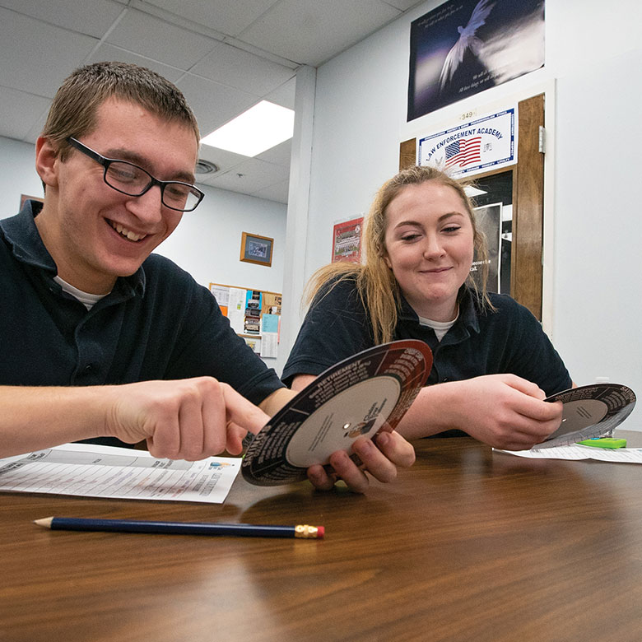
Learning Objectives & Standards
Through Claim Your Future, students will:
Consider the return on investment of future career, education and financial decisions.
Have conversations about goals and aspirations.
Describe postsecondary options and identify basic vocabulary associated with college exploration.
Create a balanced budget.
Describe benefits of saving.
Learning Standards:
Jump$tart National Standards in K-12 Personal Finance Education.

Slide 9
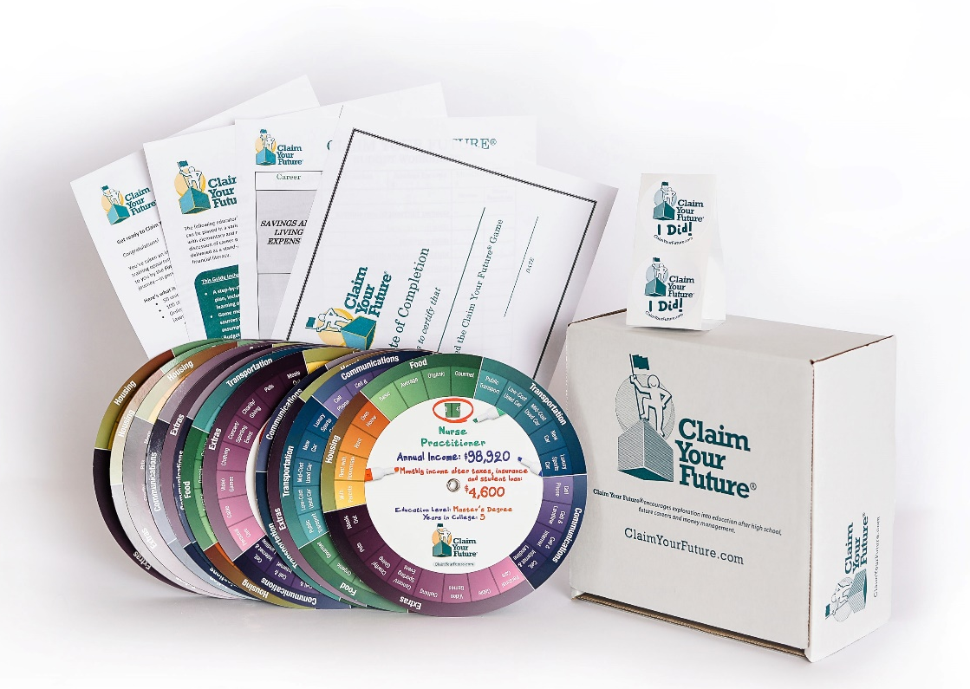
Classroom Game Kit
Each game kit includes:
50 unique wheels representing various careers
Available for download:
Educator Guide
Budget worksheets and certificate of completion
Additional resources:
Explainer videos and training webinars
Train the trainer sessions
Online game assignment

Slide 10
ClaimYourFuture.org
Website includes:
126 career options, including descriptions, key vocabulary and various spending options.
Pre/post assessment.
Visual representation of money spent.
Additional resources.
Printable budget worksheet, certificate of completion.

Slide 11
Educator Guide
Guide includes:
A detailed lesson plan, including learning objectives.
Game methodology, sources and assumptions.
Budget worksheet.
Optional activities and assignments.
Web-based resources.
Glossary of terms.

Slide 12
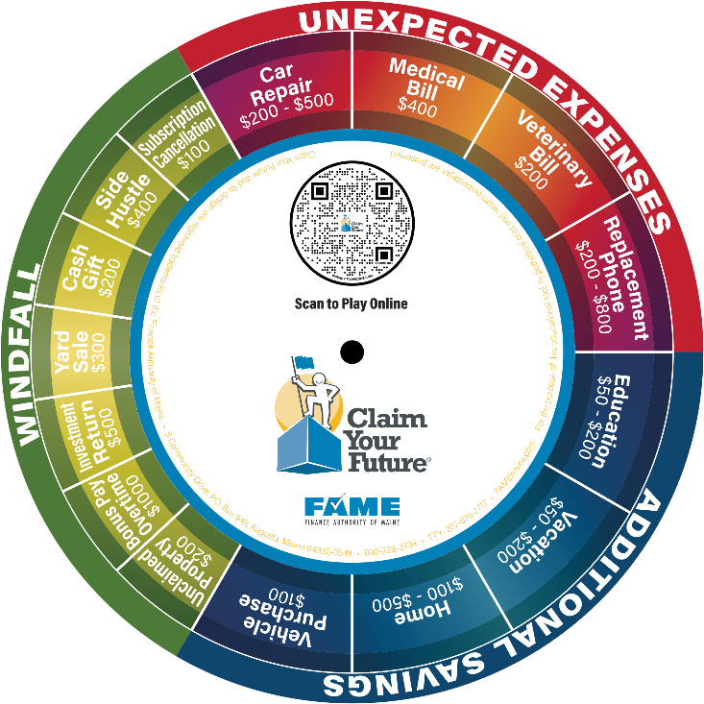
Updates and Enhancements
Updated salary and cost of living data
Career videos
Student loan decision category
Career comparison

Slide 13
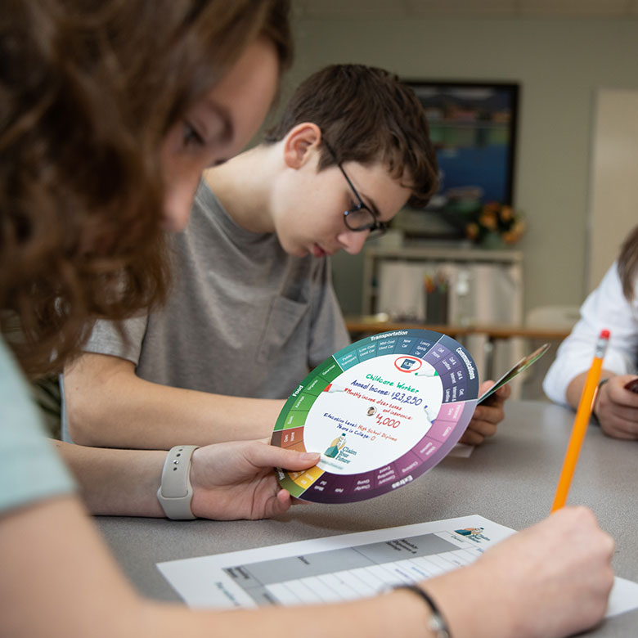
Creative Approaches to Implementation
Claim Your Future ambassador program
Jumpstart Teen Teach In - April and October
Family nights
Independent projects

Slide 14
ClaimYourFuture.org
DEMO

Slide 15
Questions?
Mary Dyer
Finance Authority of Maine
5 Community Drive
P.O. Box 949
Augusta, ME 04332
1-800-228-3734 ext. 3556
TTY: 207-626-2717
mdyer@famemaine.com

