Slide 1
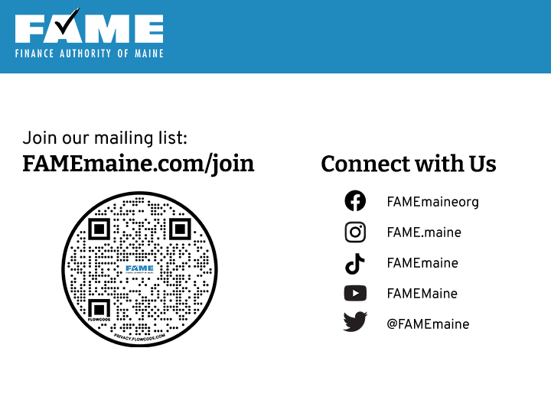

Slide 2
Comparing Aid Offers
February 12, 2025
PRESENTED BY
Michelle Radley, College Access Counselor

Slide 3
Financial Aid Process Review
Create an Account (FSA ID)
•Complete the FAFSA
•Apply to Colleges
FAFSA sent to Colleges
ONCE ACCEPTED School sends financial aid offer to the student
Notes:
To meet or beat a school’s priority financial aid deadline, students should file the FAFSA (Free Application for Federal Student Aid) at fafsa.gov ASAP. If you have students who have not yet filed their FAFSA, even if they are not sure of their fall plans, have them file the FAFSA now so they don’t miss out on aid.
When you file FAFSA can be sent up to 20 colleges
The FAFSA is processed producing a FSS (FAFSA Submission Summary) that is sent to the student and any school listed on the FAFSA. The FSS lists the student’s SAI or Student Aid Index (this is the financial fitness factor used by schools to calculate financial aid awards).
Students should carefully review the FSS and correct any mistakes to ensure an accurate SAI because this factor impacts their financial aid award. Updated SAIs are automatically sent to each school, every time the FAFSA is updated.
Usually the school will send a financial aid offer if the student is accepted. THIS PROCESS CAN VARY: Some schools send a request for documents first before sending an financial aid offer, some schools send an financial aid offer even if they are not accepted. No federal regulation on how this occurs.

Slide 4
Financial Aid Process Review
Compare Financial Aid Offers
(Net Price)
Student accepts aid (if acceptance is required)
School MAY email, call, or mail if any documents are missing
School processes accepted aid
Processed aid will appear as pending aid on bill
Apply for aid again next fall
In Today’s Webinar
Notes:
The financial aid offer is sent showing estimated aid. These looks different depending on the college seeing as there isn’t one unified format for offers. They are required to share the same information, but often takes a detail oriented individual to compare them in a uniform manner.
What our SOP is when comparing aid offers with families, is to help them determine YOUR net price of each school, so using tools we have available subtract the gift aid from the direct costs so the can be compared equally. The net price is what the true cost will be for one year of school.
Once offers compared and decisions are made, accept the aid and have the school grab the aid on your behalf.
The school will request documents to be returned if the student wants to accept or decline aid. Most schools now have a portal online for this process. Have students keep an eye on their new student email

Slide 5
What we are talking about today
Net Price
Annual cost of attendance minus grants, scholarships, tuition waivers, and any other gift aid a student receives.
The net price is individual to the individual student.
Sticker Price/COA
Total cost of attendance (COA) encompassing yearly expense for a specified school - not taking aid into account.
Notes:
The financial aid offer is sent showing estimated aid. These looks different depending on the college seeing as there isn’t one unified format for offers. They are required to share the same information, but often takes a detail oriented individual to compare them in a uniform manner.
What our SOP is when comparing aid offers with families, is to help them determine YOUR net price of each school, so using tools we have available subtract the gift aid from the direct costs so the can be compared equally. The net price is what the true cost will be for one year of school.
Once offers compared and decisions are made, accept the aid and have the school grab the aid on your behalf.
The school will request documents to be returned if the student wants to accept or decline aid. Most schools now have a portal online for this process. Have students keep an eye on their new student email

Slide 6
How Schools Determine Need
How do schools determine the aid a student receives?
All schools use the following formula:
The Cost of Attendance (COA) includes direct and indirect expenses.
The Student Aid Index (SAI) is determined when the student files the FAFSA.
Because COA varies, need varies by school.
COA
-
SAI
NEED
=

Slide 7
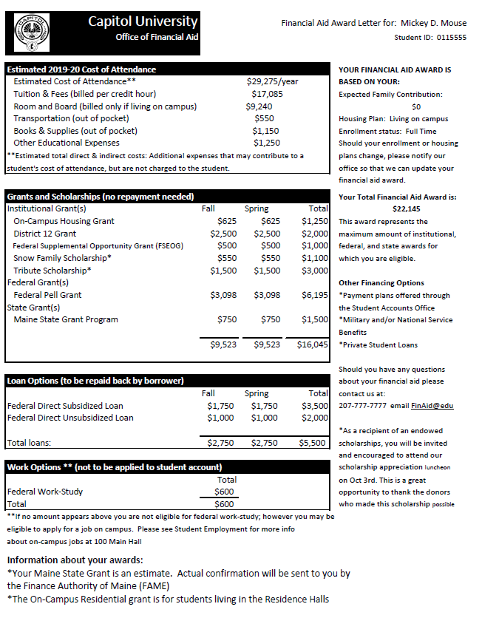
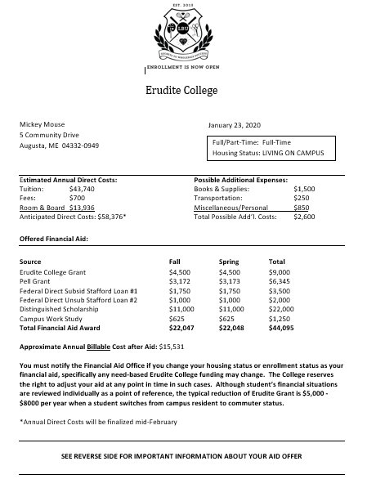
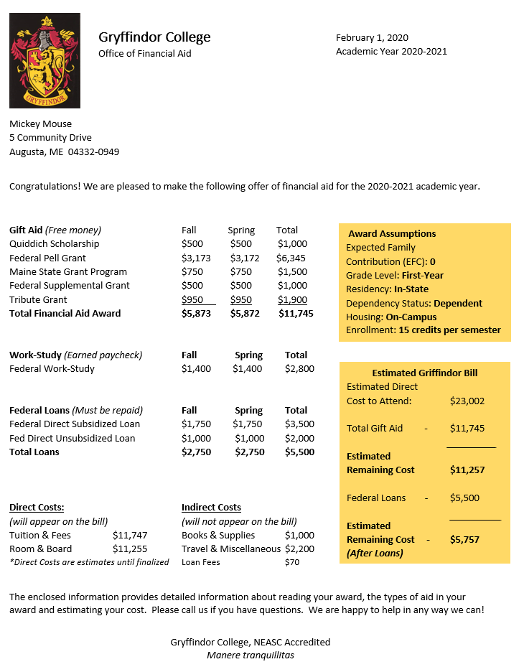
What does this mean??
Notes:
Going to go over example real offers – rebranded.
Will show you and discuss each of these aid offers:
Benefits, draw backs, different pieces of info, how to properly read them
And how we usually go about this process with families and how we break it out for understanding

Slide 8
A financial aid offer may have some combination of the following:
Cost of Attendance/Sticker Price
Gift Aid
Grants funded by Federal, State and/or School
Scholarships funded by Federal, State and/or School
Tuition Waivers or Housing Waivers
Self Help Aid
Loans funded by Federal Govt. and/or School
Work study
2025-26
Student Aid
Index (SAI): 0
Housing & Food
Notes:
There is no standard template plus each school’s policies and available resources differ, so it’s important to try to identify and compare the similar parts. Love the way this offer is broken out!
Cost of Attendance = direct and indirect costs (billed versus discretionary expenses)
When comparing Net Price, you want to focus on the direct costs, but important to acknowledge the indirect costs are there.
Indirect (not billed to you: books/travel) Direct: (on your bill, tuition/fees)
Gift Aid = money students won’t have to do anything for
Want to see a long list here!
What is this and how did I get it?
Keeps families informed: can u rely on year after year? Is it dependent on a certain behavior? (majors, sports, grades)
For this reason – is the cost sustainable over length of program?
Self Help Aid = money that student do have to do something more to get (loan documents; work; pay pack)
Logistics of work study
Remember – WS does not come directly off your bill! Typically used for things like books and living expense
Loans: Fed direct program
If student has to borrow have them start here
Diff between sub and unsub (interest, need)
Lowest fixed interest rate, not credit based, do not need cosigner, forgiveness programs, unsub options, payment plan options, deferment/forbearance
Increase eligibility of loans over education time (dependent 5.5k, 6.5k, 7.5) (independent receive more) (dependent whose parent denied for PLUS)
Highlighted will show how to accept the award AND more information

Slide 9
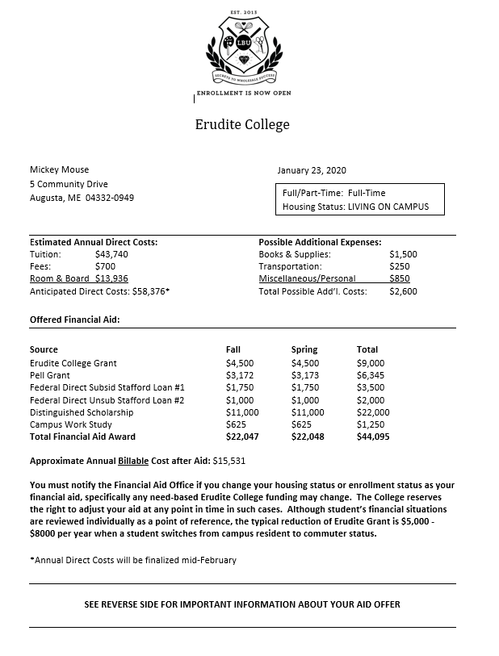
Understanding the Parts
Direct and indirect costs
What your award is based on
Is this accurate?
Work Study
Notice: Included as total aid
How you accept the aid
What are your next steps?
Notes:
On this financial aid offer you can see:
ID direct & indirect costs
Need to spend more time on thee offers w families
What the award was based on – is this accurate?
Is the student planning on living Off campus? If not contact the Financial Aid Office to let them know.
Is the student transferring in credits that the financial aid office should know about? might have enough to be considered a 2nd year student which might mean some changes in aid eligibility.
Did you make a change to your FAFSA (update with actual tax information) and your SAI has changed? This may change the aid on this letter.
Don’t like how ws is lumped in to aid? – not going to be used to pay bill. Confusing for families
Next steps

Slide 10
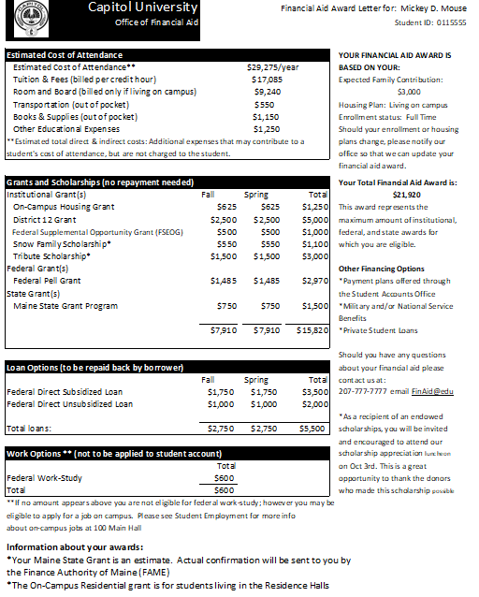
The financial aid offer will have some combination of the following:
When will you receive your aid?
Other funding options
Notices about your awards
Student Aid Index
Notes:
This financial aid offer shows:
Direct and indirect costs lumped together – help weed it out for net price
Notice that this student received an On-Campus Housing grant. If this student is planning on living off campus they would not be billed for housing and they would not receive the grant.
When the aid will be applied to your account (Fall, Spring & then the total of both semesters)
When comparing, make sure families are using the same unit throughout
Help families understand the bill will be semester BUT should consider full cost of the year.
Other funding options if you still need help paying the bill
Payment plans – make sure youre telling families about this
Benefits of no interest as opposed to SL

Slide 11
Which is the most affordable option?

Slide 12
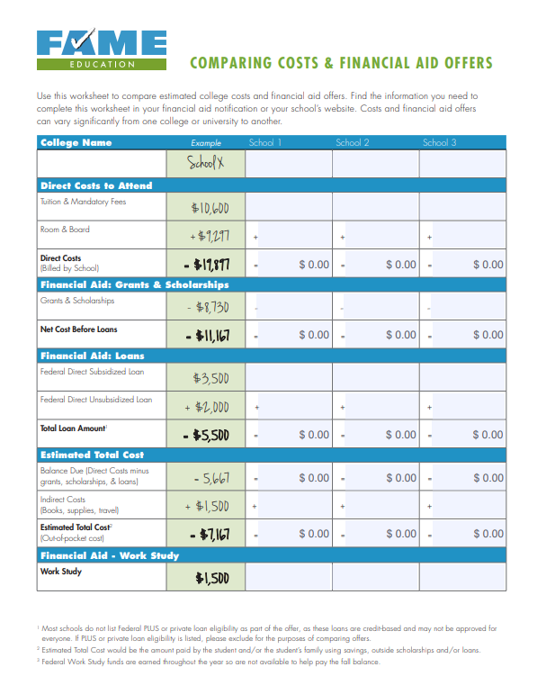
Check out FAME’s Dynamic Worksheet!
Notes:
Comparing-Awards-online.pdf (famemaine.com)
WW Offer PDF.pdf

Slide 13
Now, how do we pay the balance?

Slide 14
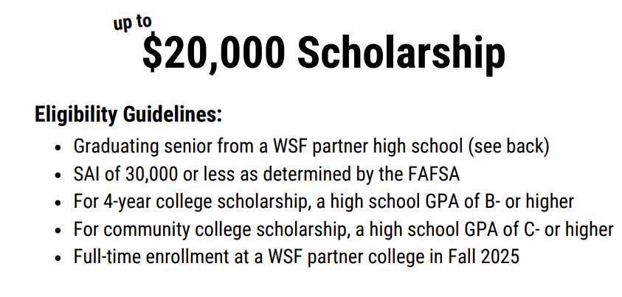
WorthingtonScholars.org
Notes:
Deadline was April 15th
Eligability: Partner HS, partner college, SAI 20,000 or less, GPA of C / B or better depending on selected college
SAI may have changed from when initial emails estimating eligibility were sent out. Changes in the back end of the FAFSA may have lowered SAI. We suggest students check their FSS for most up to date info.
Talk about impact to the bill ( 5k/yr or 3k/yr)

Slide 15
MaineCF.org
Notes:
Have students fill out a profile on here and MCF will find scholarships that match to you!
Lots of diversity for not just HS seniors but sophomore year and beyond, non traditional students, and more.

Slide 16
FAMEmaine.com/Scholarships
Notes:
Scholarships for maine students only
Filters for:
HS, college student, adult learner, major
Maine leg historically has been going unawarded – Jun 1st deadline
we administer it
16 scholarships, 1 for each county
In the neighborhood of 5 and 6 scholarships awarded over the past two years.

Slide 17
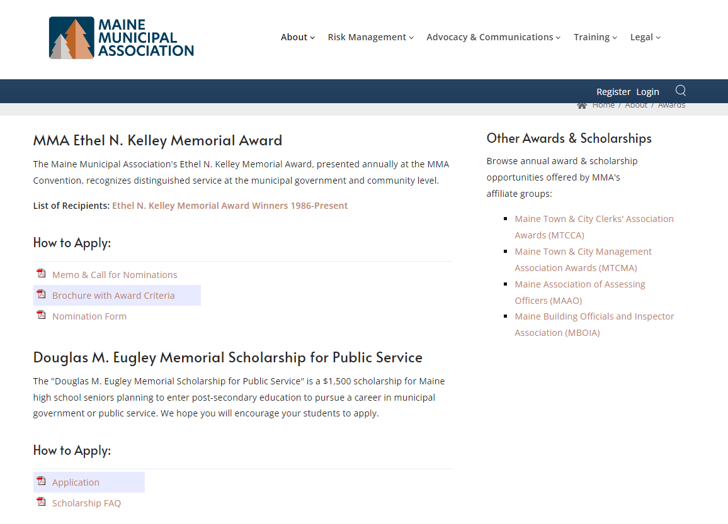
https://www.memun.org/about/awards
Notes:
Go to reputable orgs websites that may fit specific areas of study
Even try just googling their major then “scholarship”

Slide 18
What if it’s not enough?
Comparing entire cost of education vs. first year aid
Consider what funding is/is not renewable for 2nd, 3rd & 4th years?
Role of free community college?
Next months Wednesday Webinar: The Path to Paying the Bill – Tips to Afford College After Financial Aid
Notes:
Is it sustainable?
What is the plan? All savings first year then loans?
Impact of lots of non renewable scholarships?

Slide 19
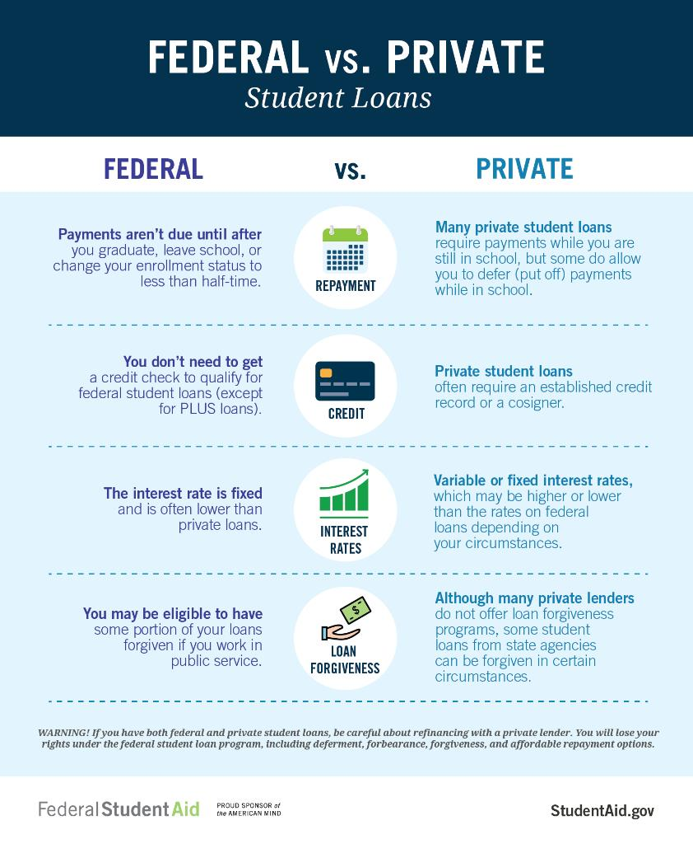
Loan Discussion
More helpful on our website:
Borrowing Student Loans - FAME Maine
Notes:
Infographic from FSA
WE have lots of useful edu tools on our website about borrowing
Federal Direct PLUS Loan for parents and graduate students is a credit-based loan. Direct PLUS Loans can help pay for expenses not covered by other financial aid.
PLUS loans require credit & are charged a loan fee a little over 4%
Private student loans are
credit-based
offered through banks, credit unions, and state agencies.
Usually, the student is the borrower and will need a creditworthy cosigner like a parent or grandparent
Each offer different programs: interest rates, fees, rate type, etc

Slide 20
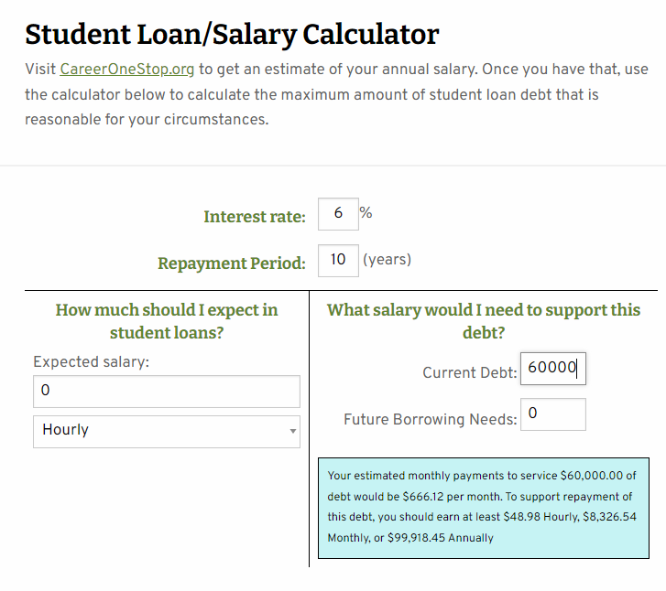
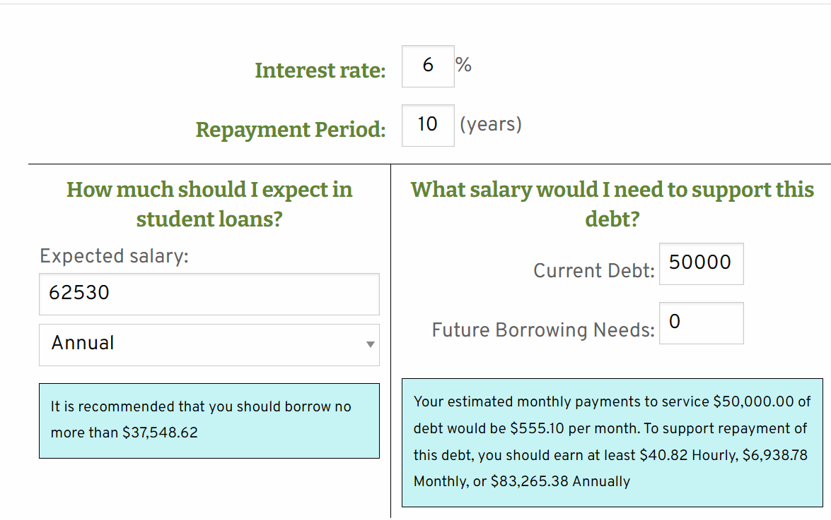
Understanding pay back
Notes:
Always save the loan discussion for last
Particularly about the SL stigma and media, drowning in student debt is those private loans.
Go over graphic:
Typical student loan repayment term is ten years. Not always the case tho, could be less and quicker!
The faster paid off, the less interest and fees.
Our websites student loan calc (ask flo to drop)
Golden rule: don’t borrow in total more than you expect to make your first year in salary – the payment will not be achievable
Go to career one stop for this info: Salary Finder | CareerOneStop – using Mechanical Engineers
Encourage students to explore this info and use these tools

Slide 21
Questions?

Slide 22
Thank you for joining us today!
Find more FREE resources and information at FAMEmaine.com/education.
Follow Us:
Contact Us:
Education@FAMEmaine.com
PH: 207-623-3263 or 800-228-3734
TTY: 207-626-2717

